Slide 1
NY Training Summit: Reporting/Dashboarding
Mike Conway, Director of Business Solutions, Northern Rivers
Dean Corbin, E.H.R. Application Specialist, The House of the Good Shepherd
Besa Bauta, Chief Data Officer, MercyFirst
November 29-30th, 2018

Slide 2
Leveraging Data for Actionable Insights
Presentation Goals: Participants for the Reporting/Dashboarding session will understand the differences between these approaches and how to utilize visualization tools to achieve agency goals and outcomes.
Reporting Approaches
    Development of Questions
      KPQs
      KPIs
    Reporting Platforms
      Data Insight
      SQL Queries
Dashboarding Approaches
  Visualization
  Data Analysis
  KPIs
  Mapping
Session Title | Duration | Session Description | Learning Objective 1 | Learning Objective 2 | Learning Objective 3
Reporting/Dashboarding | 2 hrs. | To include Q&A and live case scenario/s submitted by members | Tools Feedback | SQL codes commonly used | Lessons Learned

Slide 3
Selecting the Right Tools
Gartner Magic Quadrants
  What are some of the key metrics to consider?
    Ease of Use
    Customizability
    Cost
    Visualization
    Analytics
    Features/Functionality
    Integration
Which product is the right fit?

Slide 4
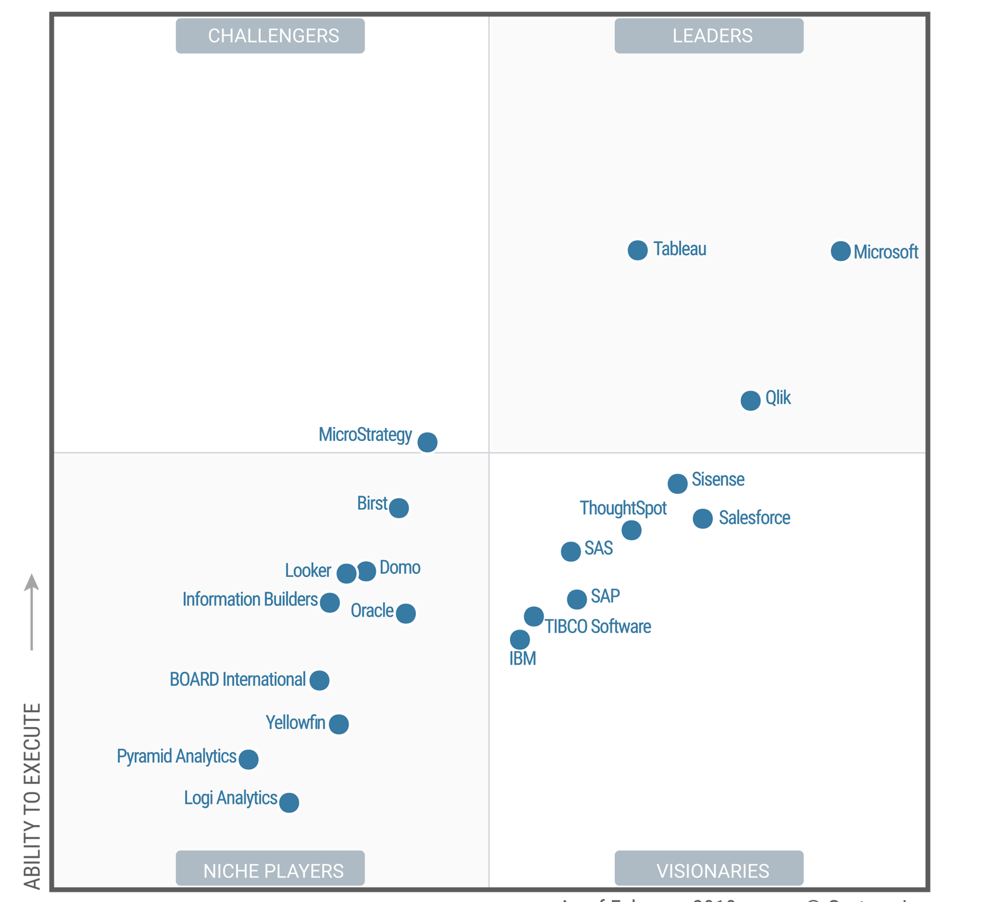
Analytics Platforms
Many Solutions
Netsmart Care Pathways

Slide 5
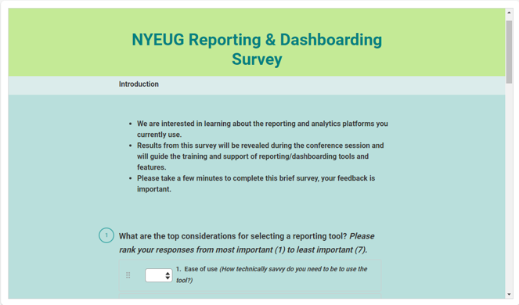

NYEUG Reporting & Dashboarding Survey
Results?

Slide 6
Results of the Survey
Q1: Top consideration for selecting a reporting tool?
  Ease of use, customizability, and features selected as the most important factors
Q2: Current reporting tools used?
  Excel, canned reports, and other tools
Q3: What tools would use?
  Tools that can export and integrate data, allows most control over the data and ease of use in creating dashboards.
Q4: Tool interests?
  Simple interfaces, drill down ability, accuracy, integration, pulling data from multiple sources (& integration), reporting features, visualization, sharing on mobile or online platforms, end user customization, and robust security features.
Q5: Learning needs?
  Power BI set up and linkages with myEvolv, customizability of reports, Data Insight, billing, treatment plans.
Request: What are others using? For both reporting, dashboarding, and data integration.

Slide 7
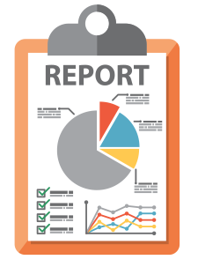

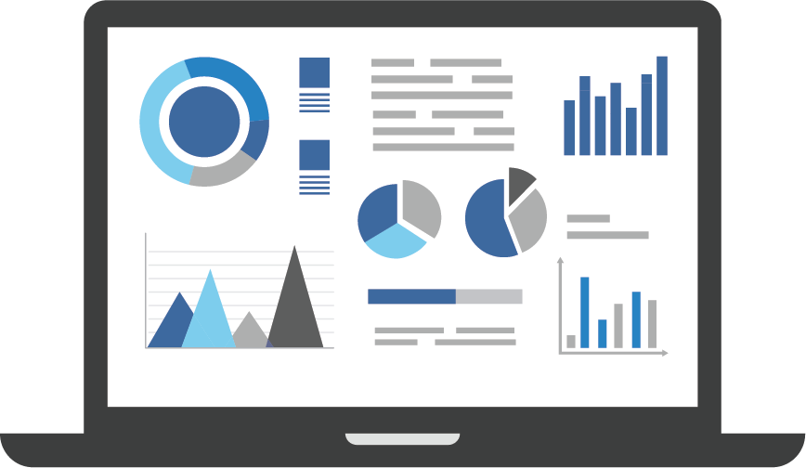
Reporting

Slide 8
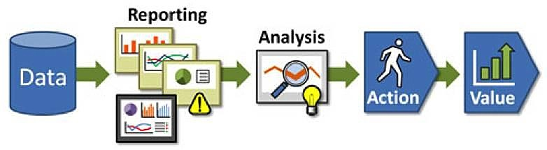
Reporting
Reporting uses data to track the performance of your business and paves the way on what questions to further ask.
  Analysis uses data to answer strategic questions about your business and attempts to answer them.
Data reporting is the process of organizing data into charts and tables in order to track performance of your business.
Notes:
From Adobe blog post:
Reporting: The process of organizing data into informational summaries in order to monitor how different areas of a business are performing.
Analysis: The process of exploring data and reports in order to extract meaningful insights, which can be used to better understand and improve business performance.

Slide 9

Data Sources, Indicators, and Outcomes
Data Sources
  Data Source Mapping within Enterprises
    Where does your data lie to answer your process/outcome questions?
Indicators (KPQs) / Outcomes (KPIs)
  Leading Indicators
  Lagging Indicators

Slide 10


Questions/Inquiries
Example: The right question to resolve a pain point
There are many ways to get at the answer
  Crafting the right question is critically important
    What is it that you would like to know to drive a process or practice?
      Clearly define your purpose
    What type of questions can be answered with your enterprise data?
      What’s available and what’s missing?
  Be Careful with Terminology and Jargon
    Example: ‘alerts’
      can refer to restrictions or internal messages in myEvolv
Notes:
Another good example with the canned reports – “How many enrollments in 2017?” Different answers if you run “Enrollments for a Period” report, which shows you how many enrollments had a start date between 1/1/2017 and 12/31/2017 and if you run the Program Enroll Grid, which shows you who all ‘touched’ a program in each month of 2017. First report leaves out anyone who was still enrolled on 1/1/2017 but began enrollment prior to calendar year 2017. Same question might mean something different to those who interpret it. Also agency enrollment vs program enrollment vs facility. Do we count one person who enrolled in 2 programs once or twice?

Slide 11
Reports
Basic Reports
Question
  KPQ: How many clients were enrolled in the past year?
  KPQ: How many clients received clinical/medical services in the past year?
    Overview of what is available
    Tracks
    Test Case Scenario with each application
Notes:
Care Day and Service Days – Residential example and Fee-For-Service example – capacity and budgets
--Billing authorizations report – for the client
--Billable services report
-mileage per event /
Easy of use / customizability – tool of choice
Changed “how many clients were enrolled… “ and “How many clients received…” – DRC

Slide 12
Overview: Reporting Tools and Platforms
Netsmart myEvolv “Canned Reports”
Netsmart myEvolv Data Insight Report Writer
Microsoft SQL Server Reporting Services (SSRS) + Microsoft Report Builder 3.0
Netsmart CarePathways™ KPI Dashboards
Microsoft Power BI/Business Intelligence Platform
Notes:
Data Insight – enrollment by Month for 12 months for canned reports

Slide 13
Demonstration and Case Example
Case Examples and Visualization by Tool | Enrollment | Service
Data Insight | P | P
SSRS | P | P
Microsoft Power BI | P | P
Netsmart KPI Care Pathways | P | P
Visualization Tools: MS PBI demonstration & Netsmart KPI demonstration
Total Client Served by Program in CY (Care Day Program)
  Total Enrollment – 1.1.17 to 12.31.17
Total Client Services in the Program in CY (Fee for Service Program)
  Total Services – 1.1.17 to 12.31.17

Slide 14
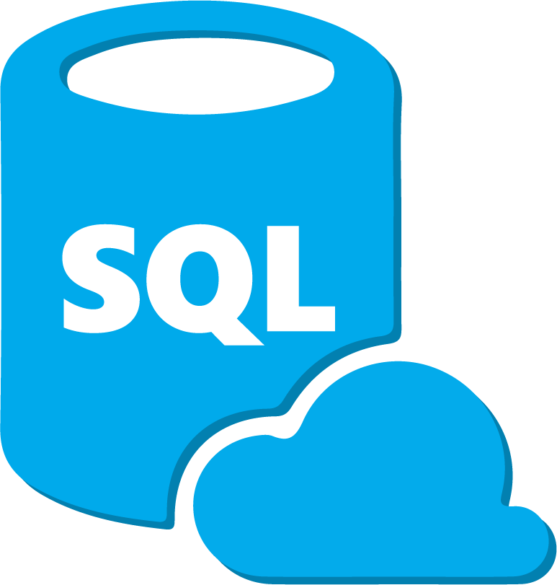
Structured Query Language (SQL)
SQL Basics – Learn the Syntax
  SELECT FROM, JOIN, WHERE, etc.
Database Structure
  Event-based system, event_log–centric database structure
Querying the Database
  Where do you execute your SQL?
Example
Resources:
  http://blog.corbinet.com/reporting
Notes:
Most of your reporting options allow you to get away with not knowing any SQL – canned reports, DI without creating custom views, KPI Dashboards, PowerBI (with fingers crossed). In the case of canned reports, DI with system views and KPI dashboards, the relationships are solid but you are limited to the core system relationships. With Power BI, it will make logical guesses about how your data is related but it may get it wrong or miss important links – guesses by assuming that people_id FK = people.people_id but what about when program_providing_service FK = program_info.program_info_id – it won’t know that one and you won’t get the data you need. PowerBI has a graphical interface for making those links but you still need to know how database is structured to make those links.
For all of the rest, you do need to be familiar with Relational Databases and how your tables relate to one another so that you can report.
Since we will likely not have time to do a SQL Crash Course in this presentation:
SQL Basics using myEvolv tables for the examples Handout – start out using it with DataInsight – make virtual views
NYEUG Training Summit Presentation from 2017 – available at blog.corbinet.com/reporting – this covers some of the specifics of the myEvolv database and how the tables relate

Slide 15
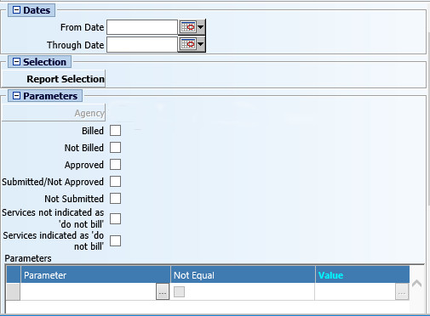
Netsmart’s myEvolv “Canned Reports”
Pros
Ready Out of the Box
My Saved Queries Widget
Conforms to myEvolv Security
Cons
Limited to Core Reporting
Severely Limited Customizability
May Never See Any New
Notes:
Pros
These reports are built and ready to go on day one. They are based on solid system views so you know they are accurate (except when bugs appear), but not reliant on a user’s query which may be flawed. These are great for quick checks on certain things.
Many users like the ability to save their parameters in a query and then name it and launch it from their home screen.
No matter what parameters a user enters into these reports, they can only ever see information on clients they have access to by myEvolv security configurations.
Cons
Limited to Core Reporting – Netsmart’s system views are built only with core functionality in mind – no custom fields, you are stuck with their idea of what things are, e.g. enrollments means enrolled in a program, not a facility – no ability to apply agency business logic where different from Netsmart’s
Customization is limited to parameter and Report Selection options, although there is the deprecated Custom Report Design tool that still works – able to use the Netsmart system views to make custom visual reports that show as Report Selections
New Canned Reports come out seldom. I don’t know if they are deprecated per se but you rarely see new reports appear. Requesting a new report would be custom development or an innovation request and you still might not get 100% of what you are looking for.

Slide 16

Netsmart’s myEvolv Data Insight Report Writer
Overview; Data Insight Reporting tool gives you the power to report out on data that resides in MyEvolv, not just with numbers, but with eye-catching charts and graphs that bring the data to life. You are able to change the filters to provide flexibility and meet your ever-changing information needs.
Pros; Simple to use
Cons; Does not have analytics and visualizing features
Learning/Resources; Netsmart wiki
Notes:
Data Insight – enrollment by Month for 12 months for canned reports (confirm if this is the case)
Leave this section for Mike to fill in, however, here are some thoughts on pros and cons
DI does not have analytics but it does do some charts. I don’t mess with them but you can do it. But you are limited to tables and a few types of charts. You do not have a full-fledged report writer.
Pros
- Hard to say if this fits in pros or cons but since it has its own security setups, that can be useful for reporting
Cons
Clunky, Buggy with caching, unable to handle large datasets and no way to pre-filter with report parameters; has to be filtered in the query if you run into a row limitation.
Remember also that I will have a video on mapping Evolv datasets that will show how to do it and discuss why you might like to do it on the blog page I created as a repository for our materials. So a Pro might be that you can use these with Canned Reports so it might have the best integration with myEvolv in that sense. Mention that at some point in this section.

Slide 17

Reporting Services (SSRS)
+ Report Builder 3.0
SSRS - software that runs on a server, provides the engine for the queries and a portal for users to run reports from.
Report Builder - report writing software that runs on your own computer and connects to SSRS to create report definitions.
Self-Hosted
Agency Active Directory
E-Mail Subscriptions
SharePoint Integration
Non-Netsmart Data Sources
Netsmart-Hosted
Agency Active Directory
E-Mail Subscriptions
SharePoint Integration
Non-Netsmart Data Sources
Notes:
Able to get a hosted version with Netsmart but it has features disabled.
Otherwise, they are largely the same.

Slide 18
Reporting Services (SSRS)
+ Report Builder 3.0
Pros
Full-featured Report Writer
Tons of Resources for Support
Direct Link to Reports w/ Parameters (Evolv form integration)
Wizards
Cons
Need Read-Only Report Server
Day-old Data*
Completely myEvolv Agnostic
Notes:
Provides a report portal for users and they do not needs to have an account in the EHR – perfect for executives who only need the 10 mile view.
Completely myEvolv Agnostic means you need to know how your data is structured to be able to get anything from it – SELECT * FROM system views will only go so far.
Then a demo of using SSRS to answer the 2 KPQ’s in ways unique to SSRS – pretty print report, table wizard for ease of use

Slide 19


Dashboarding
Notes:
Need a slide like this to start the Reporting section before Canned Reports?

Slide 20
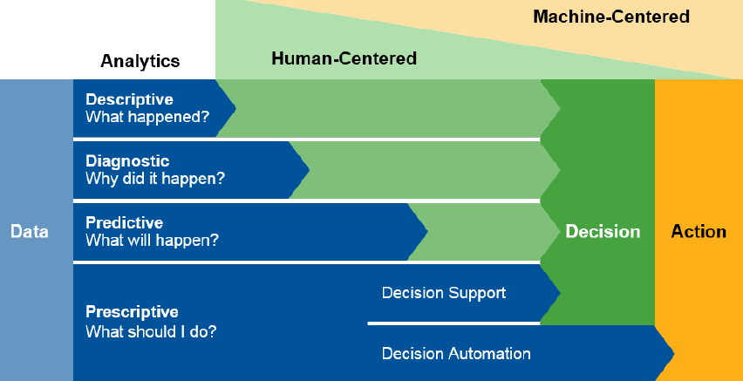
Analytics Approaches
Notes:
Transitioning from Reporting, which typically sticks to the Descriptive and into Dashboarding and Analytics, where some of these additional levels can be achieved.

Slide 21
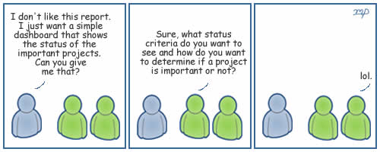
Dashboarding Basics
What is the Purpose of a Dashboard? The whole point of the web-based dashboard is that it lets you visualize the Key Performance Indicators and other strategic data for your organization at a glance.
Why are dashboards important? Gain quick insights & simplify complex data sets through visualizing data and providing end users with an awareness of current performance.
Should visualize both High and Low KPIs
    High KPIs focus on overall performance of the enterprise.
    Low KPIs focus on processes within individual departments.

Slide 22
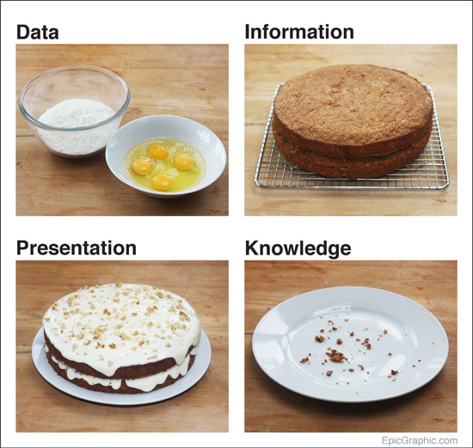
Dashboarding & Analytic Processes
Right data at a specific time to answer a key question
Linking of data components to gain insight into processes
Contextualizing data/information
Results used for decision-making

Slide 23
CarePathways™ KPI Dashboard
Overview; KPI Dashboard provides at-a-glance metrics to clinical, financial and operational decision-makers to determine if your organization is moving in the right direction to achieve organizational goals. The solution organizes and presents information to the user in a way that is easy to read and share with others.
Key Features
  Daily performance dashboard
  Performance goal setting
  At-a-glance performance status data
  Customized clinical assessment data
Pros: Data pulled from agency EHR
Cons: Timeline for integration of HR and Fiscal-GL/General Ledger systems online late 2018 and 2019. Lack of integration with other external data sources. Uses Qlik Sense for the analytics and visualization.
Learning/Resources: Netsmart wiki and resources

Slide 24
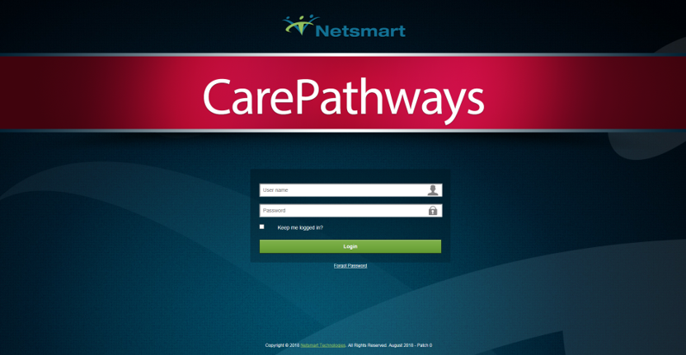
CarePathways™ KPI Dashboard
Overview & Sample Dashboard:

Slide 25
CarePathways™ KPI Dashboard
Overview of Netsmart’s KPI
  Features
  How to import data?
  How to clean data?
  How to analyze data?
  How to visualize data?

Slide 26

Microsoft
Business Intelligence Platform
Overview: Power BI is a business analytics service that provides interactive visualizations with self-service business intelligence capabilities, where end users can create reports and dashboards by themselves, without having to depend on information technology staff or database administrators.
Pros
  Web
  Desktop
  SQL Server Analysis Services (on prem) & Azure Analysis Services (cloud)
  Embedded Svs
Cons: Relies on MS Environment and doesn’t integrate well with other solutions.
Learning/Resources: Microsoft Learn Power BI (Guided Learning, Samples, and Documentation)

Slide 27
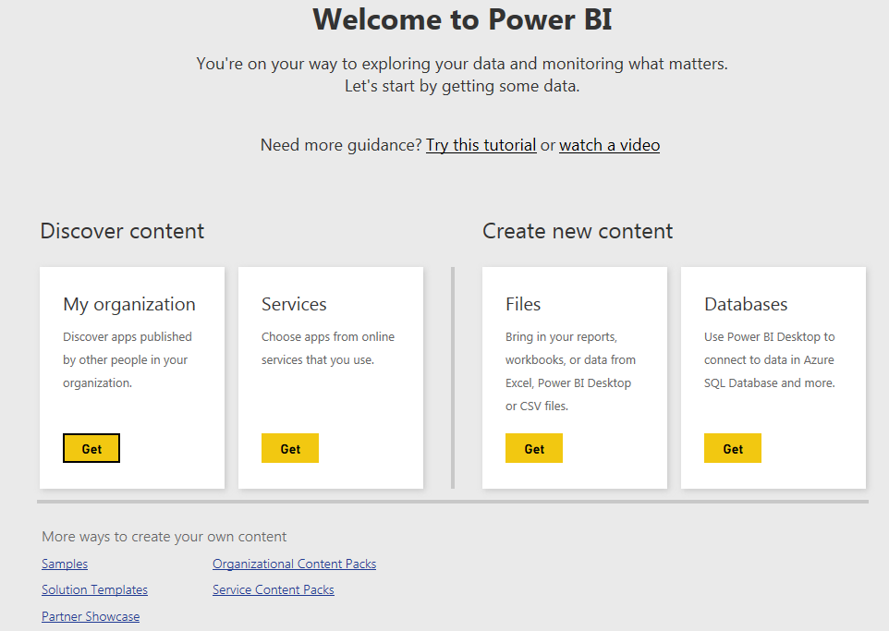
Overview
Online vs. Desktop Version
How to import data?
How to clean data?
How to analyze data?
How to visualize data?

Slide 28
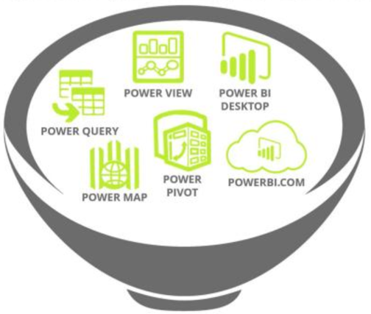
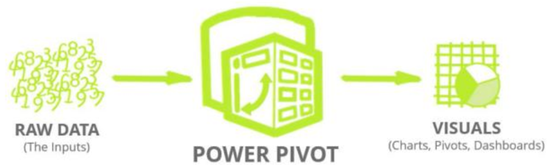
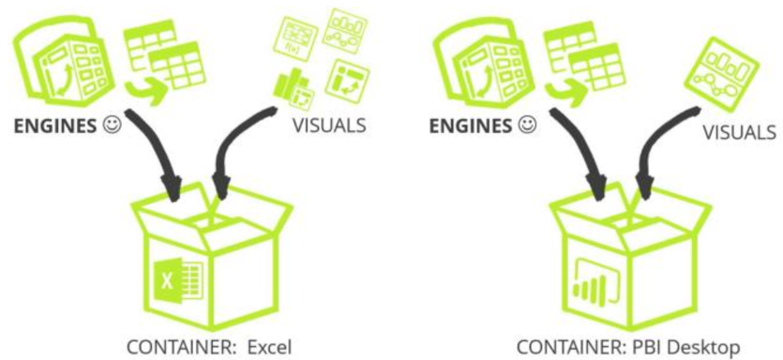
Architecture
Power Pivot / DAX aka PBI brain
Power soup
Visualization Layers
Notes:
Power Pivot is an excel feature available as an add-in and included in MS excel 2016, that extends MS analysis services in an excel workbook.
Following versions of Excel 2016 support the ‘Power Query’ functionality:
Excel 2016 – Office 365 ProPlus
Excel 2016 – Office 365 E3
Excel 2016 – Office 365 E4 andE5
Power Pivot acts as a data model, this means that the first step is to import some data. Unless it is already in your Excel sheet you will need a tool or connector to connect to different types of data sources and fetch your data. Cleaning and transformation of data. Both these functions in Excel are carried out by another add-in called Power Query (in Excel 2010 and 2013) / Get & Transform (in Excel 2013).
The final step is creating the Power Pivot data model. This is where we create the relationships between different data tables.
You can create simple measures or Key Performance Indicators (KPIs) in Power Pivot.
Finally one you have all of the required metrics calculated, you can summarize the information in your Power Pivot data model using Pivot Tables and / or Pivot Charts. The combination of multiple Pivot Tables / Pivot Charts with slicers can be used to create a Dashboard

Slide 29
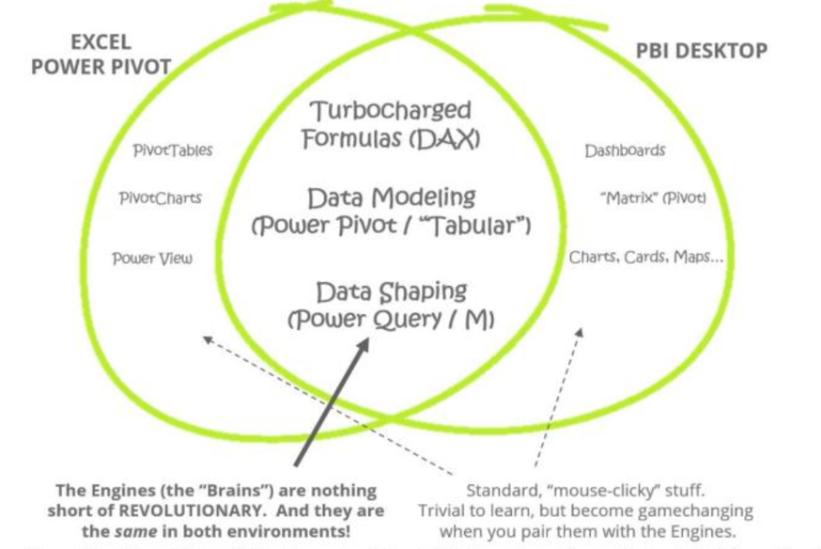
Architecture
Extension of Excel
Notes:
https://www.daxpatterns.com/
Data Analysis Expressions (DAX) in Power Pivot
DAX is NOT a programming language. DAX is a formula language. You can use DAX to define custom calculations for Calculated Columns and for Measures(also known as calculated fields). DAX includes some of the functions used in Excel formulas, and additional functions designed to work with relational data and perform dynamic aggregation.
DAX formulas are very similar to Excel formulas. To create one, you type an equal sign, followed by a function name or expression, and any required values or arguments. Like Excel, DAX provides a variety of functions that you can use to work with strings, perform calculations using dates and times, or create conditional values.
However, DAX formulas are different in the following important ways:
If you want to customize calculations on a row-by-row basis, DAX includes functions that let you use the current row value or a related value to perform calculations that vary by context.
DAX includes a type of function that returns a table as its result, rather than a single value. These functions can be used to provide input to other functions.
Time Intelligence Functionsin DAX allow calculations using ranges of dates, and compare the results across parallel periods.
Data shaping is a common task in Excel that involves reducing and rearranging one or more tables into a subject table that matches your data analysis requirements.Power Query provides an intuitive user interface to help you define data shaping and transformation steps with simple user actions over a set of data.
Comparing tabular and multidimensional solutions; https://docs.microsoft.com/en-us/sql/analysis-services/comparing-tabular-and-multidimensional-solutions-ssas?view=sql-server-2017

Slide 30
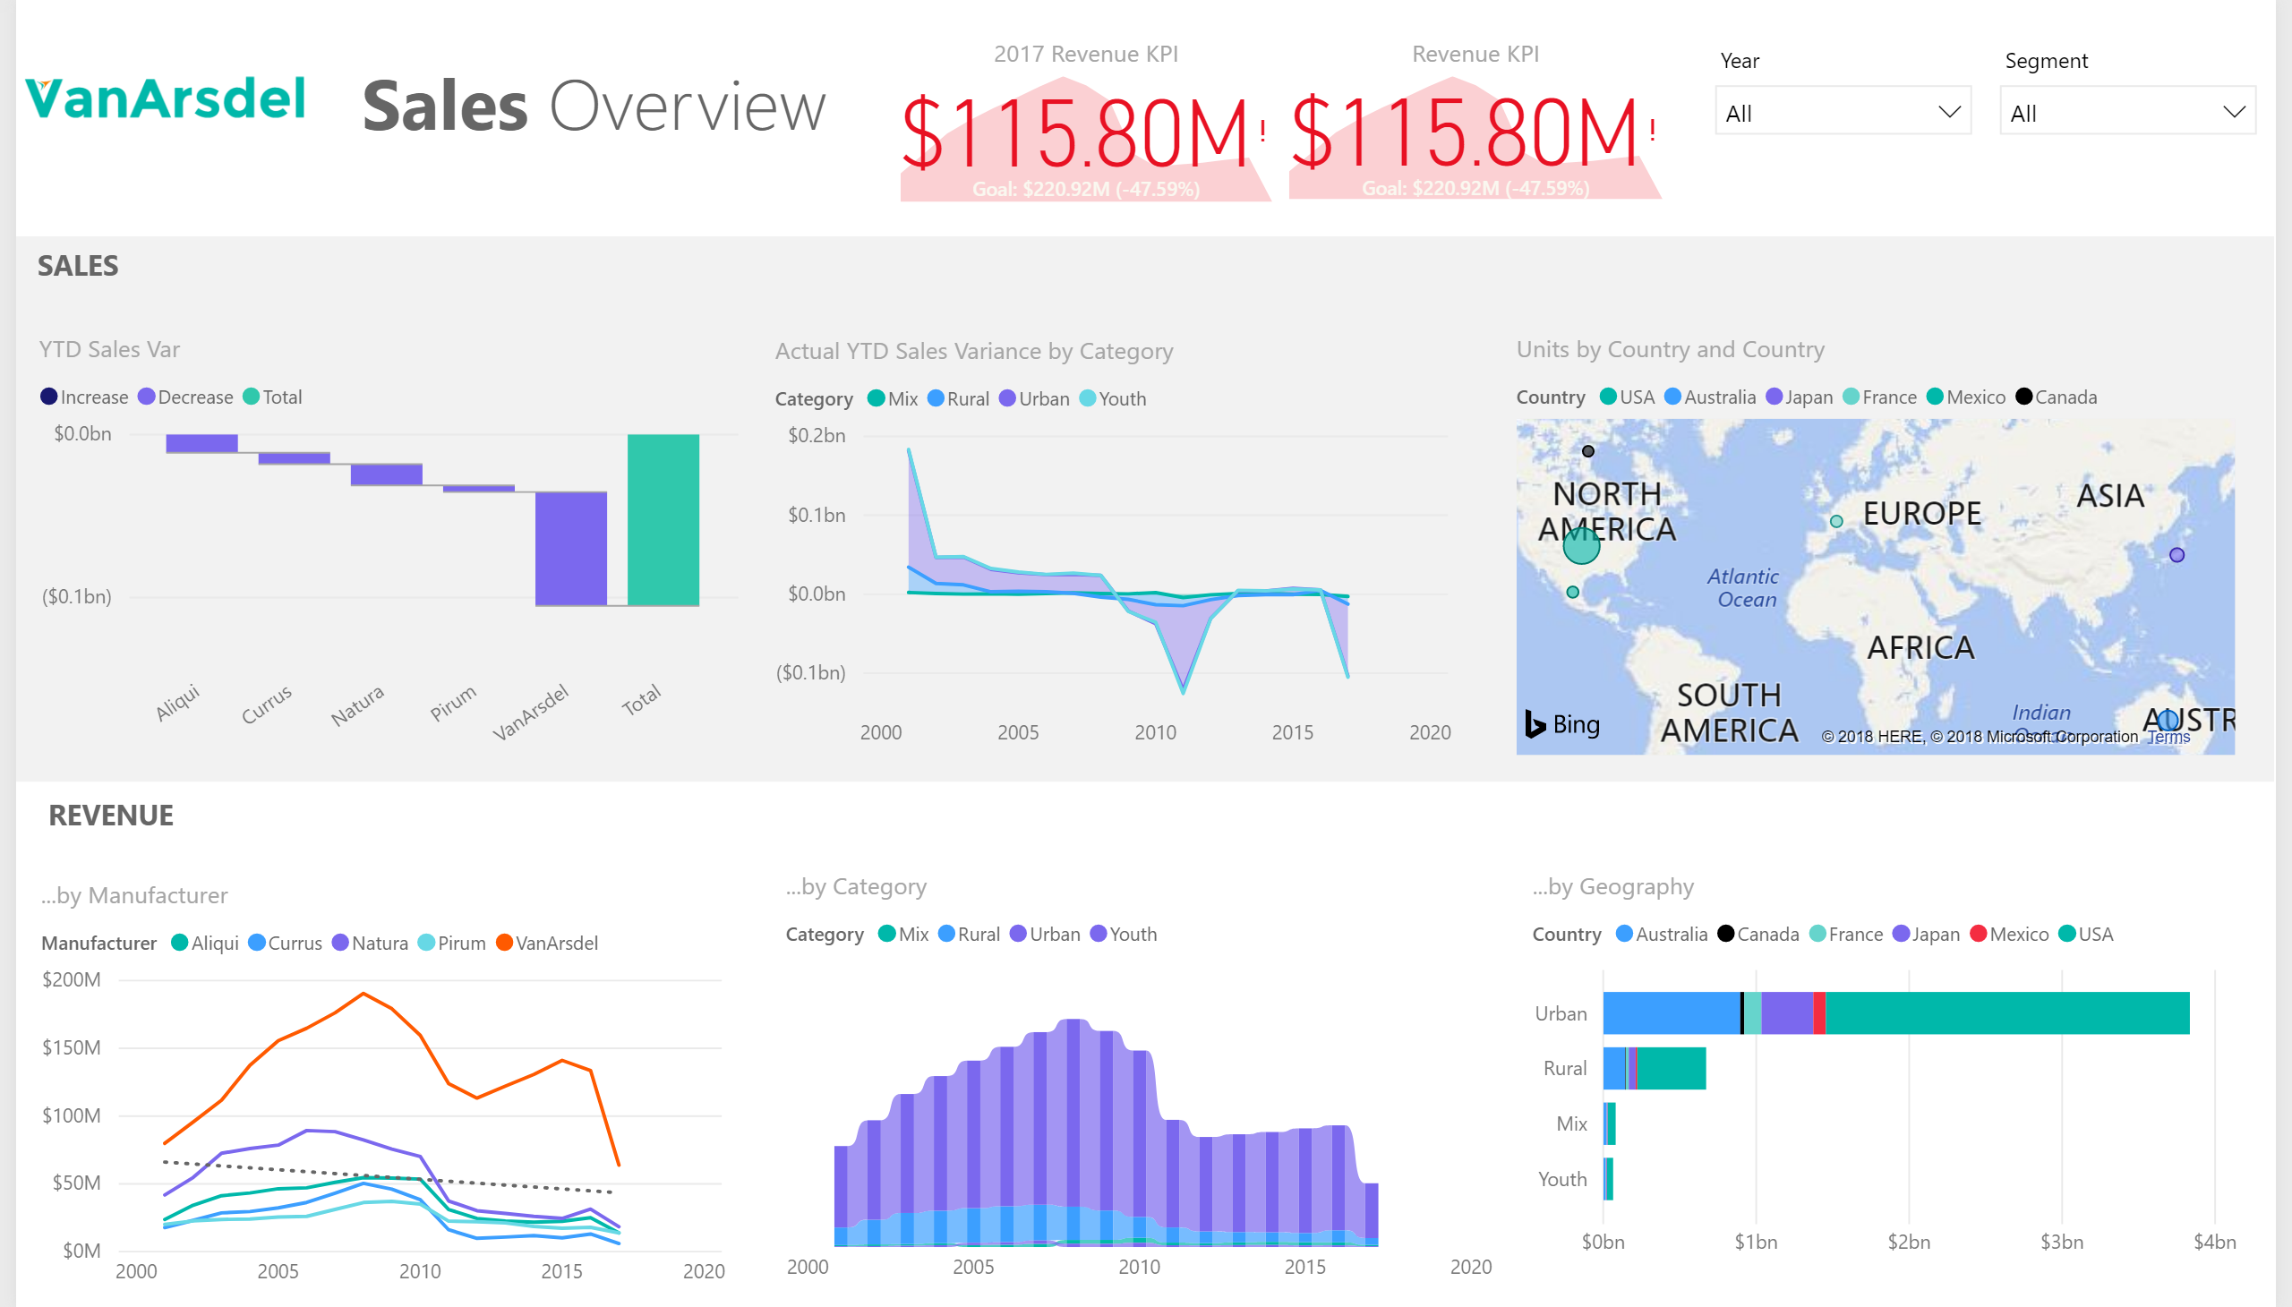

Slide 31
Other Options: Final Takeaways
Pros and cons & words of wisdom
Bringing in other data sources (Data integration)
Firewalls with regards to data
  Protected Health Information/HIPAA and restrictions for data sharing and visualization
There are multiple reporting options
  Learning curve for each of these solutions – but it’s doable
Don’t leave reporting to after the fact!
  Think about your data plan and reporting options and building this into the implementation process
  Think about reporting when you are designing forms
  Table joins create are often the where problems arise– KISS/Keep it Simple!

Slide 32
Other Options: Final Takeaways
Pros and cons & words of wisdom
  What do you want to get out of the systems when you design the system?
    Get feedback from the stakeholders from the front end
    Longitudinal view regarding what you will need in the future
    Think about your resource allocation and planning for the future
    Thinking about the questions ahead of time

Slide 33
Learning/Training Resources
Training
  Microsoft Learning Academy
    PowerBI, SSRS/Report Builder
  Lynda.com
  Netsmart Training
    Data Insight, KPI Dashboards
  CodeCademy
    SQL & Analytics
Web Site Resources
- support.microsoft.com
- stackoverflow.com
- experts-exchange.com
- w3schools.com
Notes:
Add content

Slide 34


Questions?

